Slide 1



InsurAI :- AI Powered Insurance Web Platform
A Smart, Faster & Personalized Insurance Experience Team: A
Presented By: Abhishek Kumar
Technology: React, Spring Boot, MySQL Presented To : Infosys Springboard

Slide 2
Problem Statement?
Insurance discovery process is slow
Users struggle to compare plans clearly
No real-time updates on application status
Agents spend time on repetitive processing
Vision
“To make insurance simple, fast and personalized using smart automation and secure digital workflows.”

Slide 3

Core Objectives
Simplify policy discovery & application process
Automate agent approvals & notifications
Provide secure digital onboarding
Enable data-driven decisions using AI in future

Slide 4

Solution Overview
InsurAI is a web-first insurance portal where:
✔ Users discover & apply for best-fit plans
✔ Agents manage applications & approvals
✔ System automates communications
& paperwork

Slide 5
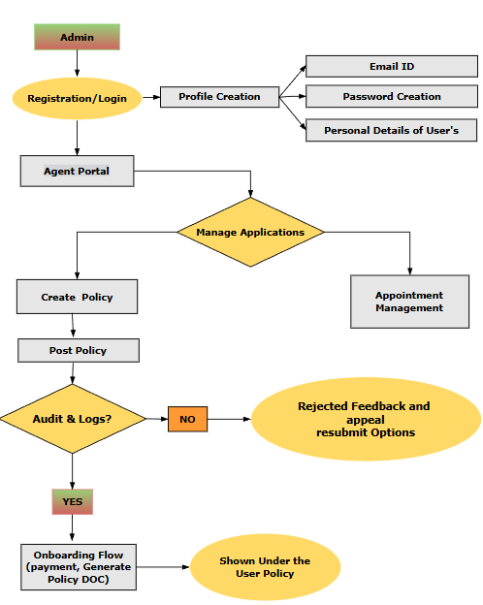
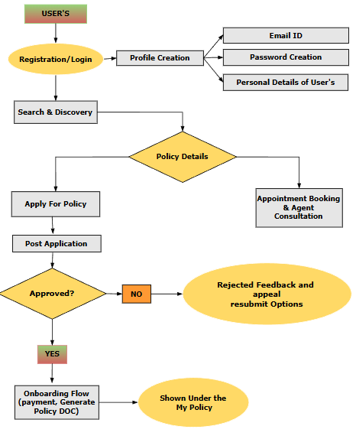
Demo Flow:

Slide 6
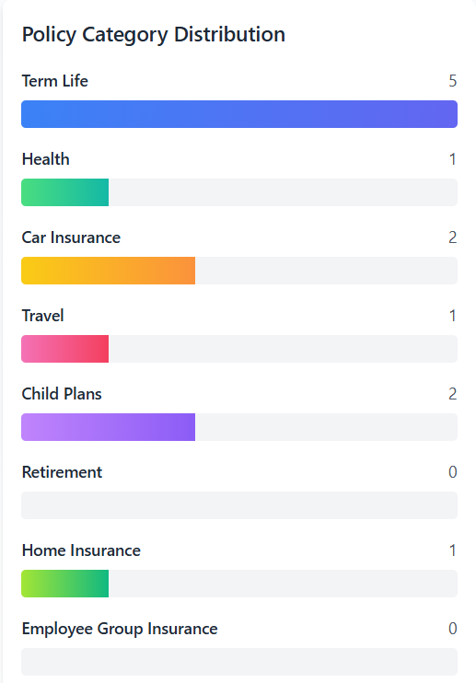
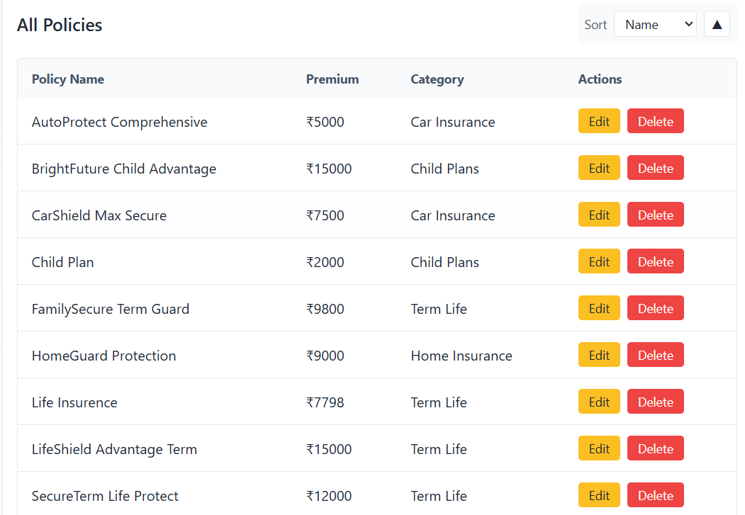
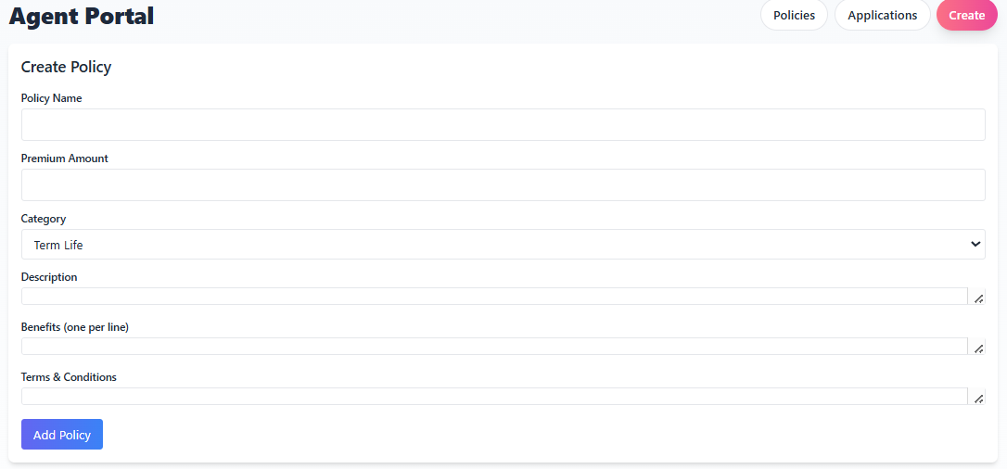
Key Features (Agent/Admin Side)
Add/Edit/Delete insurance policies
Review & approve/reject applications
Manage appointments & user communications
Dashboard analytics (approval rate, volumes)

Slide 7
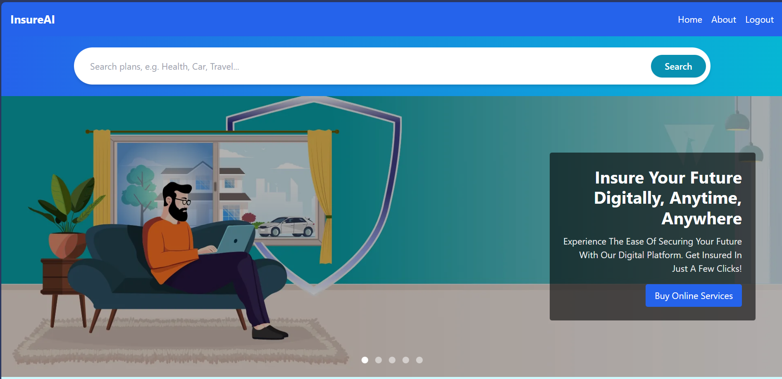
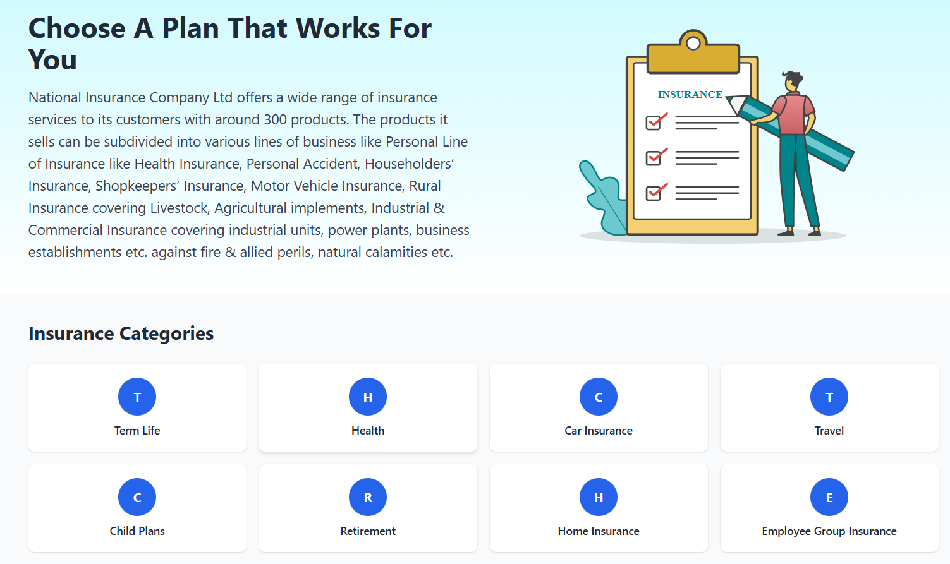
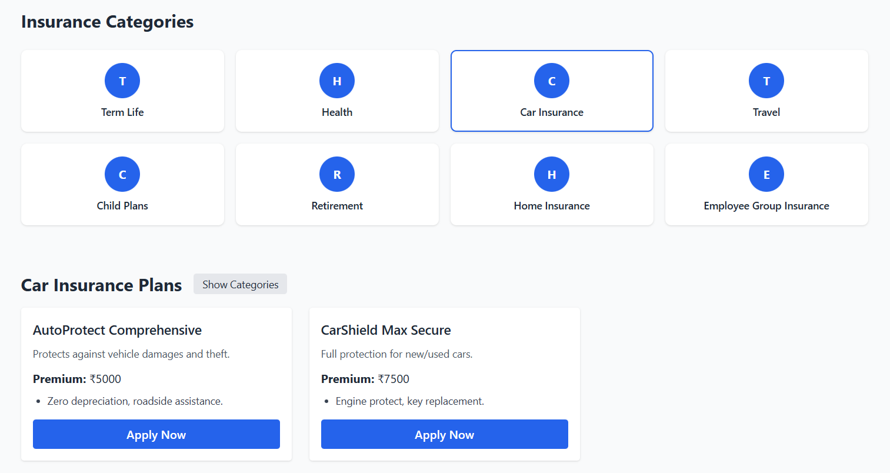
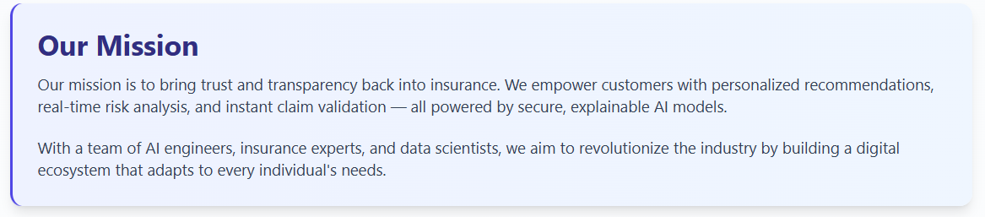
Home Page Highlight
search bar for fast discovery
insurance categories
Dynamic policy listing
Guest users prompted to login before applying

Slide 8
Future Scope of InsurAI
AI recommendations & smart assistants
Fraud detection & automated risk scoring
Online payments & claims module
Analytics dashboards & live notifications
Mobile app expansion & multilingual support

Slide 9
Thank You!
Name : Abhishek Kumar College : Noida Institute of Engineering & Technology

